Slide 1


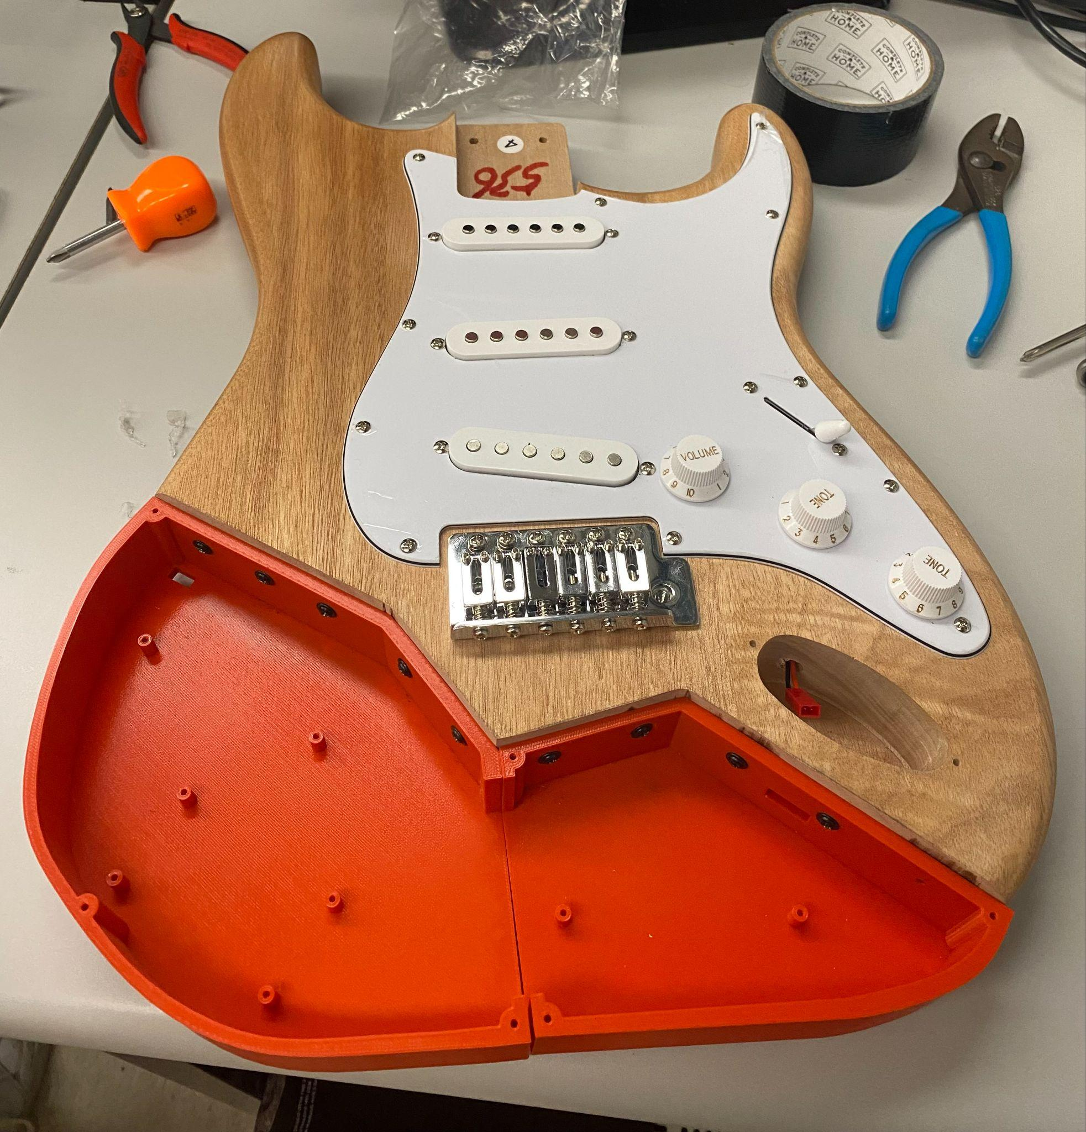
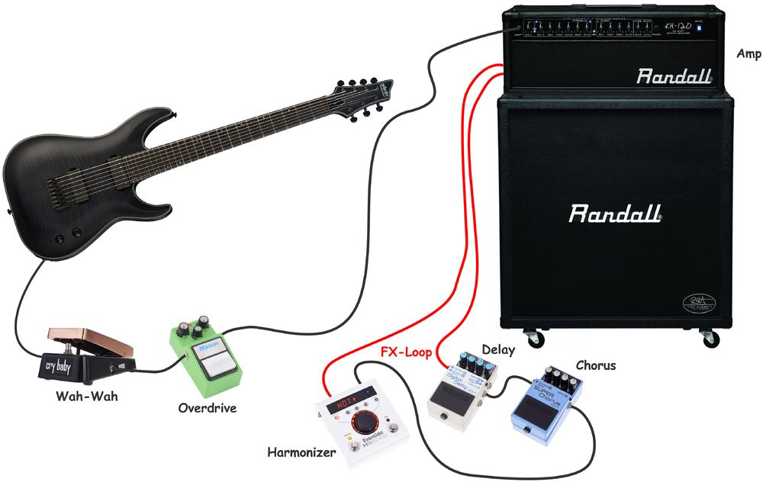
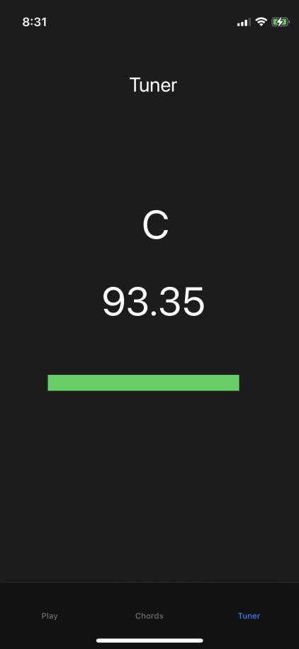
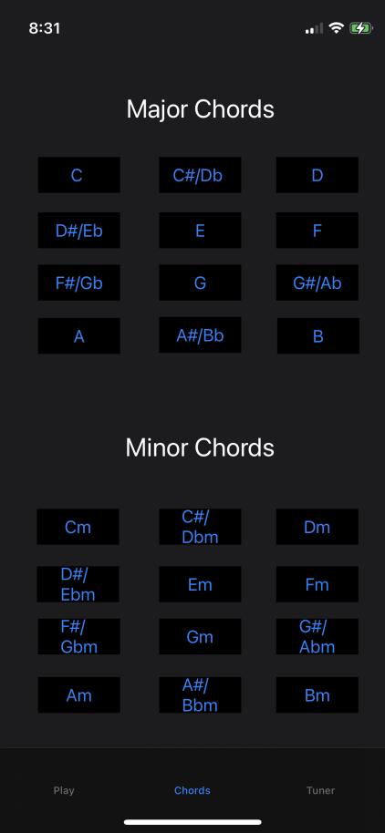
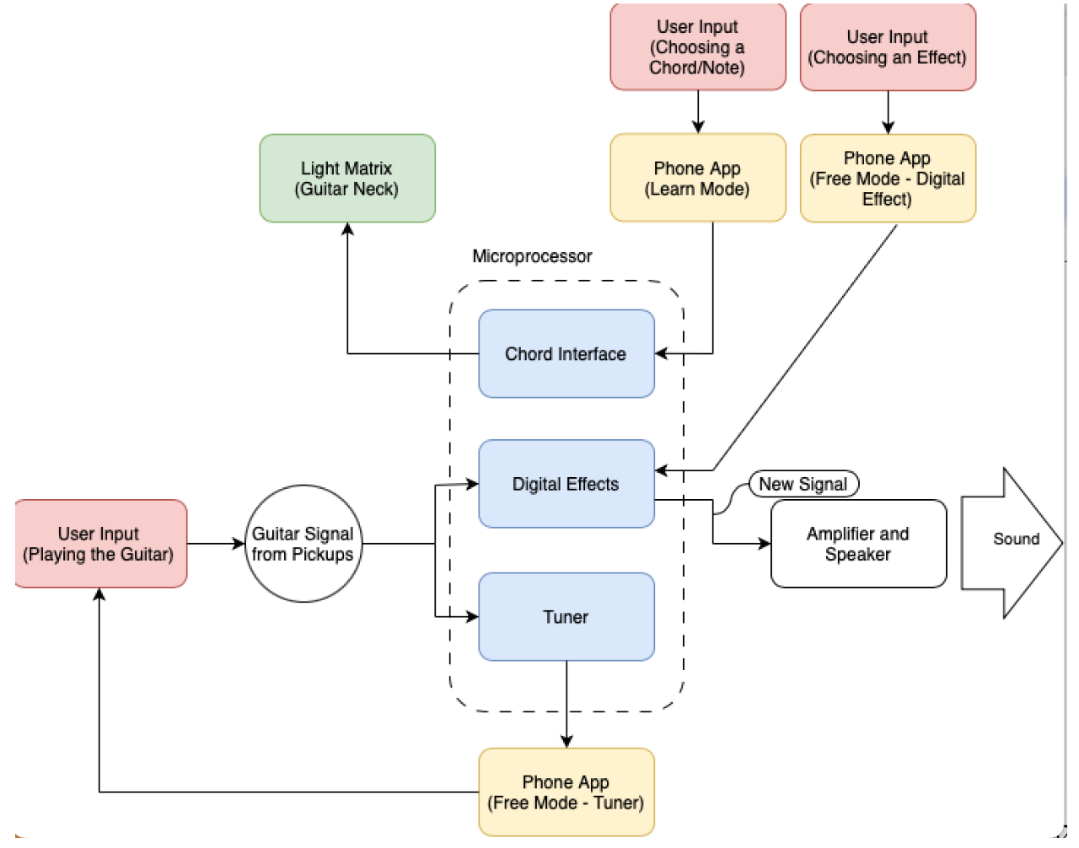
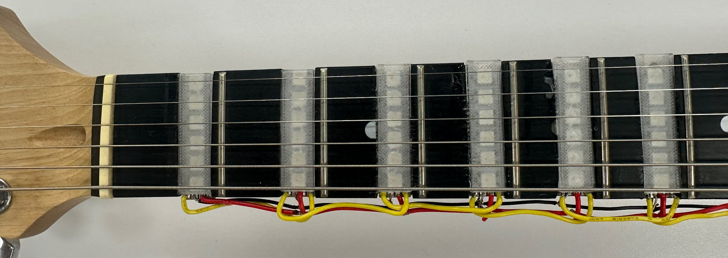
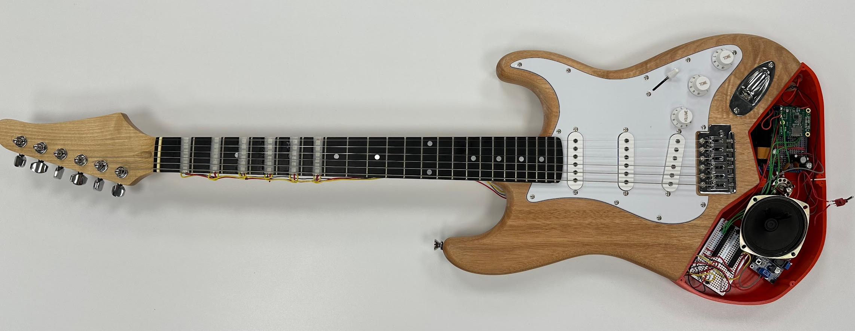
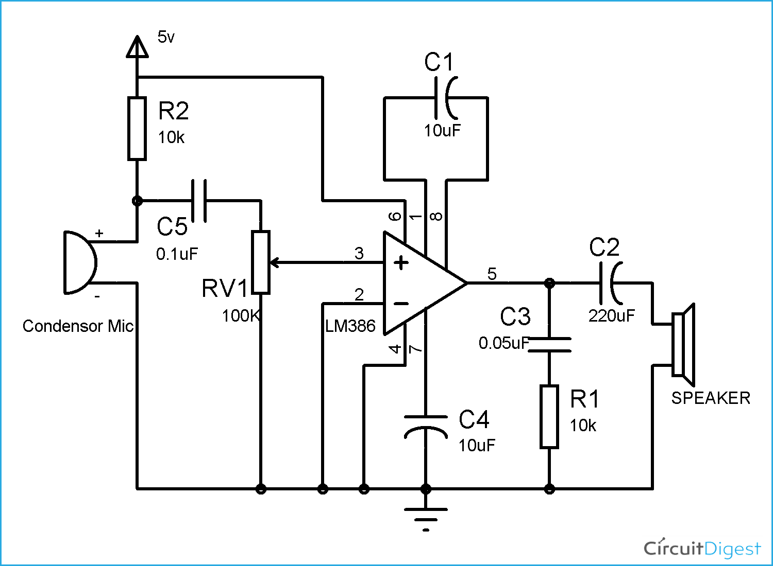
Strumtech: Innovative Guitar System
for Beginners
David Ellis, Austin Petersen, Gerald Stanford, Michael Ward
CAPSTONE Senior Design 2023-2024, Department of Electrical and Computer Engineering, University of Delaware
PROBLEM STATEMENT
APPROACH
COMPONENT and SYSTEM TESTING
When a person decides to learn how to play the electric guitar, acquiring all of the equipment necessary to play poses a large barrier of entry to the instrument. Along with the actual guitar, players need to purchase an amp and cables. Then they will need a tuner, in order to make sure that their strings are the right tones. Finally, if they want to use different effects to emulate their favorite guitarists, purchasing multiple guitar pedals, or a digital guitar pedal, requires more cables to the correct arranging of these pedals to create the proper sound.
j
Our approach to this project was to complete the hardware and software incrementally, then designing the compartment in the guitar to store the circuitry. First, we worked on most of the hardware to provide a basis for our software. We completed the circuits for the tuner, amplifier and LEDs to allow for the writing of software for these components. After writing this software, we designed the circuit for the digital effect pedal and wrote the software for this. Once the software and hardware was complete, we worked to design the actual guitar. We purchased a guitar kit, as it provided all of the base components; the neck, body, circuitry, etc. Looking at our guitar kit, we knew we would need space within the body of the guitar to store all of the hardware. Therefore, we decided that we would have to cut part of the guitar off and replace it with a 3D printed shell to store our components. Finally, we needed to install the LEDs into the fretboard and implement all of the hardware into our guitar body shell.
Our guitar contains two 3D printed
compartments to house the electronics.
This was done because there wasn’t
enough room in the body of the guitar.
We used a bandsaw to cut the guitar and
attached the prints using five screws in
each. There are also screw holes on the
bottom allowing us to secure the boards in
place. The top is a laser cut acrylic sheet.
This was chosen so that anyone may look
inside to see the wiring.
Our guitar also interfaces with an app
that allows for the changing of the
LEDs on the fretboard and the changing
of the audio effect, along with reading the
frequency of the note with the highest
amplitude. On the right we have
screenshots of the app which show how
we interface with the guitar. With the LED
Fretboard and Digital Effects, interfacing
is only done by pressing a button. With
the tuner, all the user does it read off the
value and change the string tone
accordingly.
Figure 4: 3D Printed Guitar Compartment
DESIGN
There are three modes in our design. First, the Learn Mode allows for interfacing with the LED fretboard by selection of a chord. Second, the Digital Effect Mode allows the user to pick an effect, which is subsequently heard when the user plays the guitar. Finally, there is the Tuner Mode, which allows the user to see the current note that is being played, allowing for the adjustment of the string to the right tone. This mode also creates a direct feedback loop with the user.
Below we have the schematic of the audio amplifier circuit we used for this project. We also connected the circuitry of the guitar to the audio jack, to allow for sound to be heard from either the on-guitar audio amplifier to an external amplifier, which provides better sound quality.
Figure 1: Example of a Guitar Setup
GOALS and REQUIREMENTS
The overall system goal is to design a complete and functional guitar and learning environment that will allow the user to enjoy the fulfillment that comes with not only playing an instrument but also learning one. In our guitar, we want the following components:
Audio Amplifier
Tuner
Digital Effect Pedal
LED Fretboard Array
All of these built-in components would limit the excess purchases of these items and the management of them for somebody with little experience.
In order to aid in the development of a new player's growth, we have provided visual aid to the user in the form of the LED Fretboard Array. These LEDs show the user where their fretting hand should place their fingers for the chords they intend to play. By utilizing a database of common and potential chords the user would like to play, the user selects a chord and are shown exactly where their finger should be placed on the fretboard. This allows the user to become familiar with different chords and chord patterns without needing to fully understand the fretboard initially or needing to consult external sources, such as lesson books or the internet, which can take additional money and or time that can be spent simply playing and practicing.
Along with the LED Fretboard, the built in Tuner and Digital Effect Pedal will allow easy use by the user to effect the proper tone on their strings and to change the sound of their guitar.
Figure 5: Tuner and LED Fretboard Displays on App
Figure 6: LED Fretboard
PROJECT STATUS
Our base project goals were completed. The guitar has functionality with the speaker, tuner, digital effects, and LED fretboard. We had secondary goals of creating lessons and songs on the app, however time did not permit their implementation. Further iterations of the project would include this functionality.
Figure 2: Block Diagram of the System
Figure 3: Audio Amplifier Circuit Schematic Drawing
Figure 7: Beginner Guitar

